Slide 1

Odumare Tech
ENHANCING MASTERCLASS REGISTRATION AND TECH COURSE SELECTION
CAPSTONE FOR JUNE 2024 COHORT

Slide 2
Odumare Tech
Statement of Problem
Difficulty in tailoring marketing strategies to student interests;
Time-consuming individual consultations for course selection;
Need for personalized recommendations.

Slide 3
Odumare Tech
Objectives
Analyze student registration data to inform marketing strategies and program development;
Develop a chatbot solution for personalized course recommendations;
Enhance student experience through efficient course selection

Slide 4
Odumare Tech
Data Description
Student registration dataset (gender, location, course interests);
Informal survey dataset (interests, hobbies, soft skills).

Slide 5
Odumare Tech
Insight
Demographic analysis (gender, location);
Course interest trends.

Slide 6
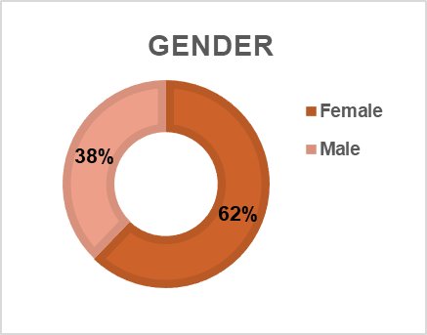
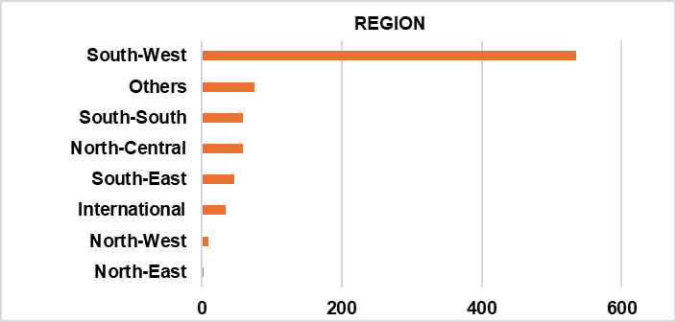
Odumare Tech
DEMOGRAPHIC ANALYSIS
Gender
Female gender students have the highest percentage of 62 against the male gender.
Location
South-western part of Nigeria has the highest number of students (535) while North-Eastern part has the least (2).

Slide 7
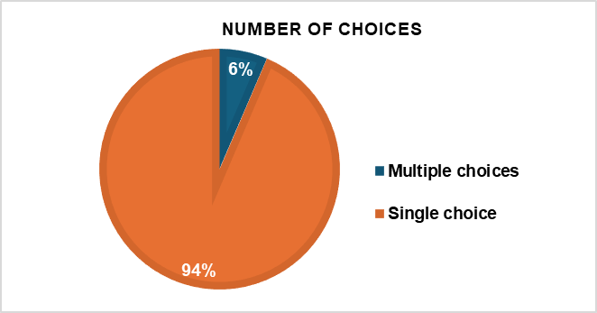
Odumare Tech
Choice of Course
Number of Choices
Students interested in one (single) course has the highest percentage (94%) while those with multiple choices has the least percentage (6%).

Slide 8

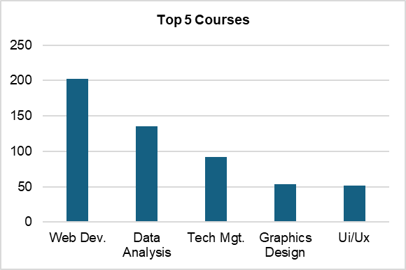
Odumare Tech
COURSE INTEREST TREND
Number of Choices
The top three courses are Web Development with 202 counts, Data Analysis with 135 counts and Tech. Management with 92 counts.

Slide 9
Odumare Tech
Findings
Demographic Distribution: The majority of students are female, and the southwestern region of Nigeria has the highest student enrollment.
Course Interests: Over 90% of students have a single course interest, with web development, data analysis, and tech management being the top three most popular courses.
Regional Disparity: There's a significant regional disparity in student enrollment, with the northeastern region having the least number of students.
Diverse Course Preferences: Although most students are interested in a single course, 6% have multiple course interests, indicating a need for flexible and personalized course recommendations.

Slide 10
Odumare Tech
Recommendations
Targeted Marketing: Tailor marketing strategies to focus on the southwestern region of Nigeria and female demographics to optimize student recruitment;
Course Prioritization: Prioritize development of web development, data analysis, and tech management courses to meet high demand;
Regional Outreach: Implement outreach programs to increase student enrollment in underserved regions, particularly the northeastern part of Nigeria;
Questionnaire Refinement and Data Standardization: Questionnaire should be structured and standardized to enhance easy data sorting and analysis for future iterations.

Slide 11
Odumare Tech
THANKS FOR YOUR ATTENTION!
PRESENTATION BY: OLAWALE QUADRY

